Slide 1
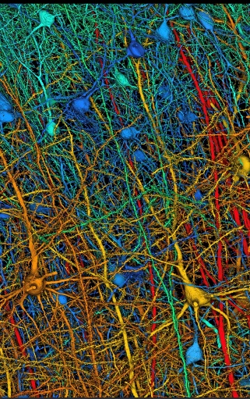
NEURAL NETWORKS
Prof. Dr. Mehmet Önder Efe
Department of Computer Engineering
Hacettepe University, Ankara, Turkey
http://web.cs.hacettepe.edu.tr/~onderefe/
e-mail : onderefe@gmail.com

Slide 2
Multiple Dataset Learning
Can a neural network learn multiple datasets simultaneously?
Consider simple problem: Each dataset has the same input vectors but different target output values.
Find a masked NN such that each one of the datasets are learned for a particularly selected mask.

Slide 3
Gradient Based Case
M.Ö. Efe, B. Kürkçü, C. Kasnakoğlu, Z. Mohamed, Z. Liu, "A Modified Levenberg Marquardt Algorithm for Simultaneous Learning of Multiple Datasets," IEEE Transactions on Circuits and Systems II - Express Briefs, vol.71, no.4, pp. 2379-2383, April 2024.

Slide 4
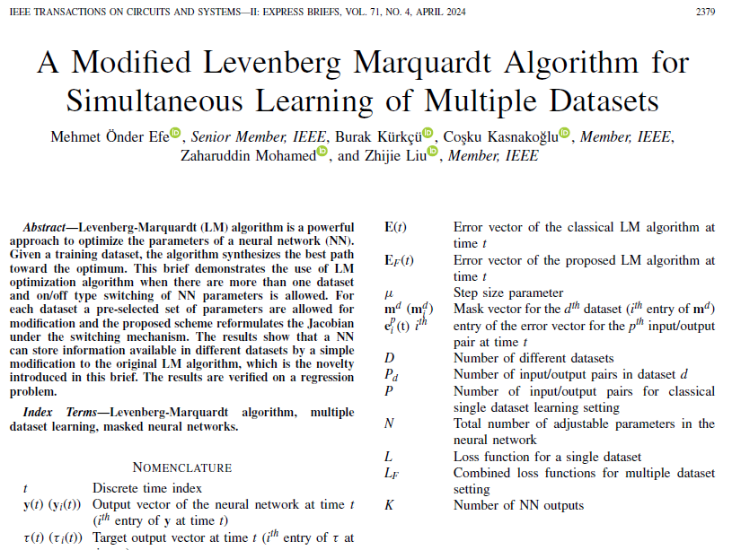

Slide 5
Introduction
Levenberg-Marquardt (LM) algorithm is a powerful approach to optimize the parameters of a neural network (NN).
Given a training dataset, the algorithm synthesizes the best path toward the optimum.
This study demonstrates the use of LM optimization algorithm when there are more than one dataset and on/off type switching of NN parameters is allowed.

Slide 6
Introduction
For each dataset a pre-selected set of parameters are allowed for modification and the proposed scheme reformulates the Jacobian under the switching mechanism.
The results show that a NN can store information available in different datasets by a simple modification to the original LM algorithm.
The results are verified on a regression problem.

Slide 7
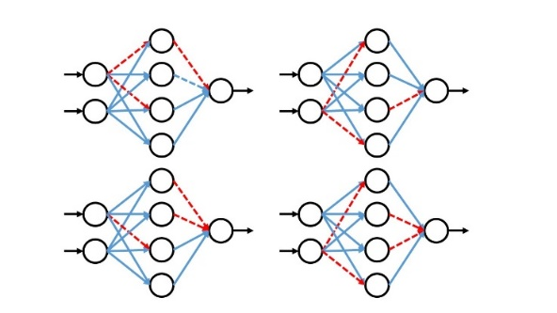
Introduction
Note that gradient information is available for this NN structure

Slide 8
On/Off Type Masking
According to the figure, we deduce two immediate facts for the masking mechanism.
  Every single parameter (weight or bias) must be active at least for one dataset.
  The masking scheme must allow information flow from each input to each output.

Slide 9
Nomenclature

Slide 10
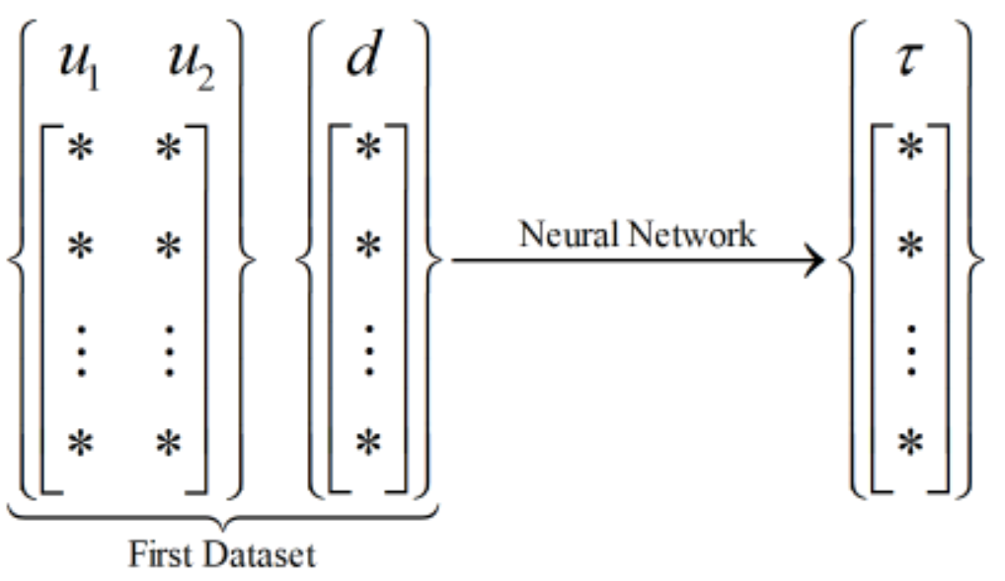
A Dataset to Learn

Slide 11
Levenberg-Marquardt Algorithm for Single Dataset Case

Slide 13
Algorithm 1
1 : t=1;
2 : L=Inf;
3 : μ=1;
4 : PerformanceLevel = ChooseLevel;
5 : SetNeuralNetwork
6 : while L > PerformanceLevel
7 : E = [];
8 : J = [];
9 : % Pattern loop
10 : for p = 1 to P
11 : y = ForwardPassPattern#p
12 : % Append sample error τ − y to E
13 : E= [E ; τ − y]
14 : % Loop over each output of the NN
15 : for k = 1 to K
16 : Row_of_J = [];
17 : % Parameter (weight/bias) index
18 : for i = 1 to N
19 : Compute ∂e_{k}^{p}/∂w_{i}
20 : Row_of_J = [Row_of_J ∂e_{k}^{p}/∂w_{i}]
21 : end

Slide 14
Algorithm 1 Cont’d
22 : J = [J ; Row_of_J]
23 : % One row of J(t) is ready and appended
24 : end
25 : % One K×N sub-block of J(t) is ready
26 : end
27 : % J(t) is ready, update now
28 : w(t+1) = w(t) − (μ I+J(t)^{T}J(t))⁻¹J(t)^{T}E(t)
29 : DistributeNewValuesToTheirPositions
30 : L = E^{T}E
31 : DisplayCost L
32 : Update_μ_IfNecessary
33 : RunEarlyStoppingRoutineIfNecessary
34 : t = t+1;
35 : end

Slide 15
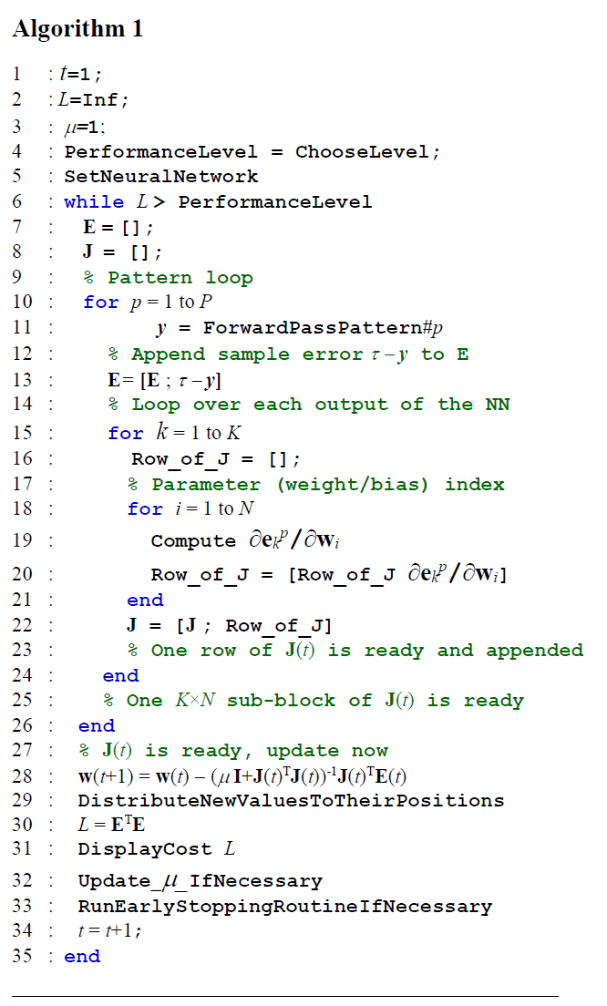
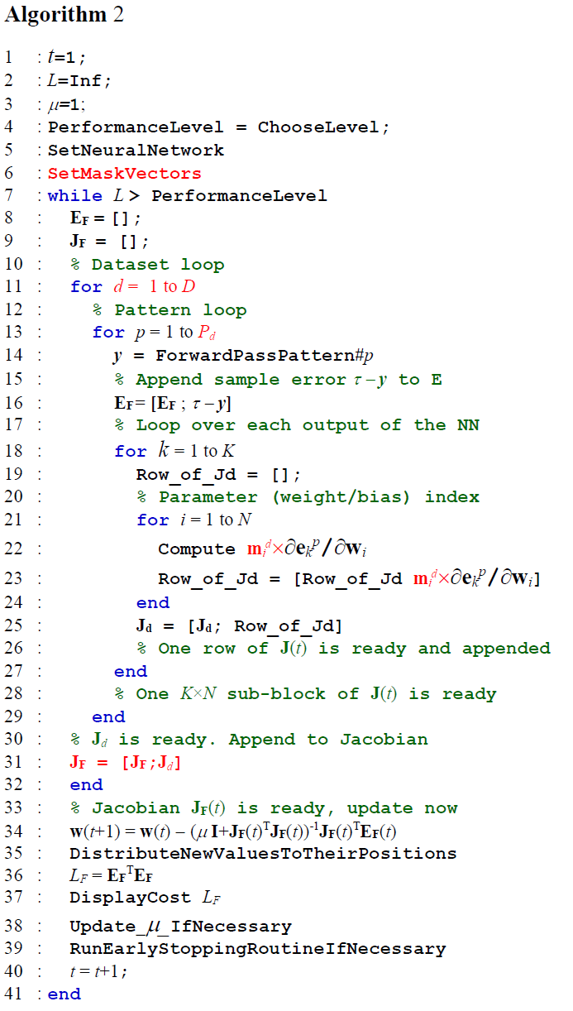

Slide 16
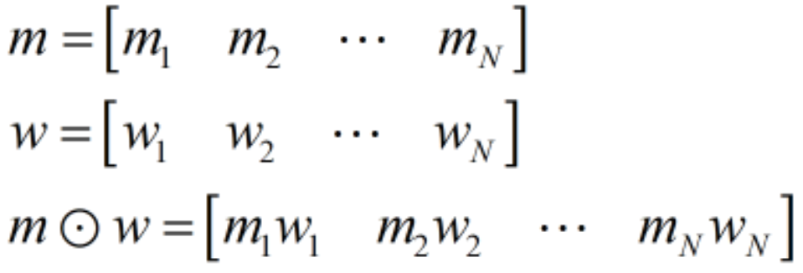
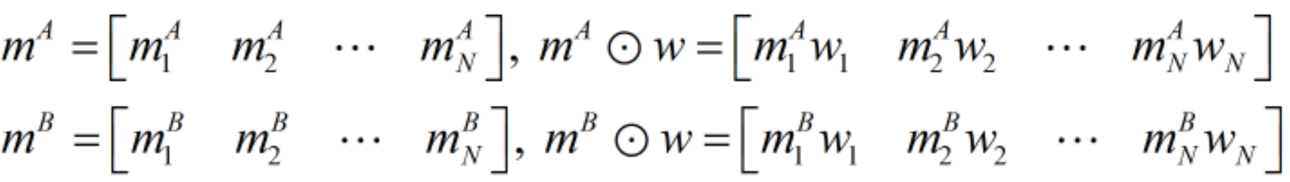
Modified Levenberg Marquardt Algorithm
Mask, weight and masked weight
Element-wise multiplication
Multiple masks lead to multiple subnetworks

Slide 17
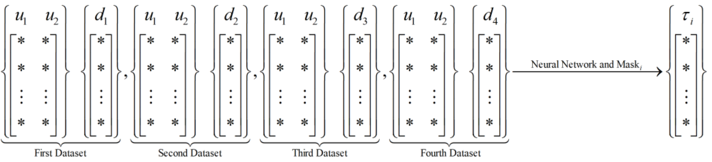
Multiple Datasets
Find out a mask associated to each dataset and a frozen real weight/bias vector

Slide 19
Modified Levenberg Marquardt Algorithm
Real parameter vector dimension is the same, i.e. N

Slide 20
Algorithm 2
1 : t=1;
2 : L=Inf;
3 : μ=1;
4 : PerformanceLevel = ChooseLevel;
5 : SetNeuralNetwork
6 : SetMaskVectors
7 : while L > PerformanceLevel
8 : E_{F} = [];
9 : J_{F} = [];
10 : % Dataset loop
11 : for d = 1 to D
12 : % Pattern loop
13 : for p = 1 to P_{d}
14 : y = ForwardPassPattern#p
15 : % Append sample error τ − y to E
16 : E_{F}= [E_{F} ; τ − y]
17 : % Loop over each output of the NN
18 : for k = 1 to K
19 : Row_of_Jd = [];
20 : % Parameter (weight/bias) index
21 : for i = 1 to N

Slide 21
22 : Compute m_{i}^{d}×∂e_{k}^{p}/∂w_{i}
23 : Row_of_Jd = [Row_of_Jd m_{i}^{d}×∂e_{k}^{p}/∂w_{i}]
24 : end
25 : J_{d} = [J_{d}; Row_of_Jd]
26 : % One row of J(t) is ready and appended
27 : end
28 : % One K×N sub-block of J(t) is ready
29 : end
30 : % J_{d} is ready. Append to Jacobian
31 : J_{F} = [J_{F};J_{d}]
32 : end
33 : % Jacobian J_{F}(t) is ready, update now
34 : w(t+1) = w(t) − (μ I+J_{F}(t)^{T}J_{F}(t))⁻¹J_{F}(t)^{T}E_{F}(t)
35 : DistributeNewValuesToTheirPositions
36 : L_{F} = E_{F}^{T}E_{F}
37 : DisplayCost L_{F}
38 : Update_μ_IfNecessary
39 : RunEarlyStoppingRoutineIfNecessary
40 : t = t+1;
41 : end

Slide 22
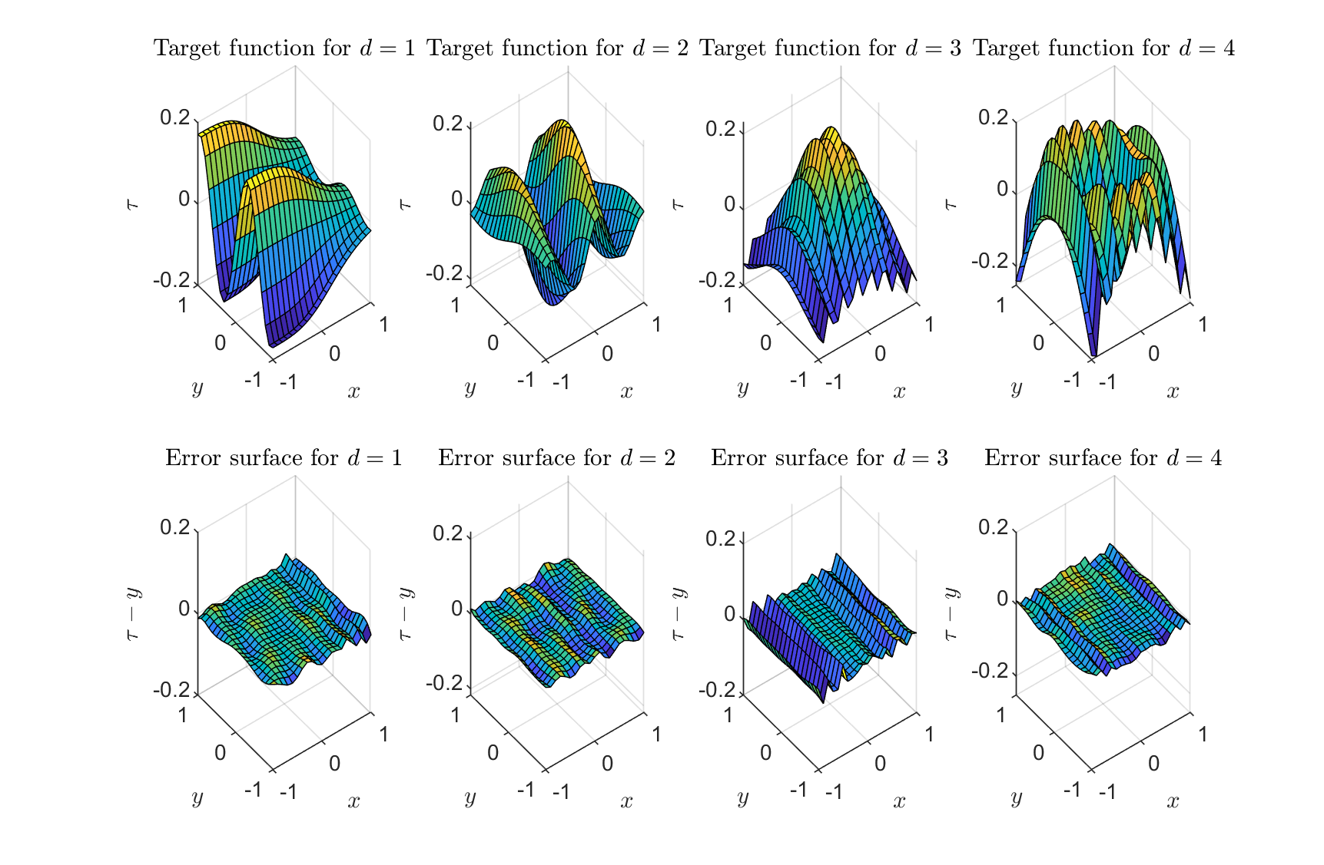
An Illustrative Example
Four orthonormal surfaces (functions) were chosen to make sure that the datasets have no similartiy

Slide 23
An Illustrative Example
After 2000 iterations of running Algorithm 2, MSE decreases to 9.882e−5 and the results shown in the previous slide are obtained. According to the figure, the NN is proved capable of learning multiple datasets simultaneously.
Since the training considers all training samples together, the proposed scheme is not vulnerable to the well known catastrophic forgetting phenomenon.

Slide 24
Setting the Subnetworks
We will Show how to initialize the elements of the mask vector ( ). For this, define a random variable (u) that distributes uniformly between 0 and 1. Based on this, we adopted the following scheme:
d = 1,2,…,D; i = 1,2,…,N
Threshold

Slide 25
Setting the Subnetworks
The chosen threshold above is 0.3. One can increase or decrease this threshold to obtain similar results.
As the threshold approaches 0, it becomes difficult to learn any of the datasets as the degrees of freedom allocated for each dataset reduces and the subnetwork activates few parameters. As the threshold approaches 1, it becomes impossible to learn multiple datasets as most parameters are kept active for all datasets.
Depending on the size of the NN, one should be aware of this and choose a reasonable value that generates a good learning performance.

Slide 26
Setting the Subnetworks
Threshold and NN size must be chosen such that…
Weights used for #1
Weights used for #2
{w}₁
{w}₃
{w}₂
{w}₁₄
{w}₁₅
{w}₅
{w}₆
{w}₄
{w}₇
{w}₈
{w}₉
{w}₁₀
{w}₁₁
{w}₁₂
{w}₁₃
Weights used for #4
Weights used for #3
{w}₁₆
This must be empty set, otherwise a parameter is inactive for all datasets!

Slide 27
Conclusions
We propose a modification to the Levenberg Marquardt algorithm.
The approach allows learning of multiple datasets simultaneously and catastrophic forgetting is prevented.
Each dataset is accompanied by a mask vector that activates a particular parameter set resulting in a subnetwork.
The obtained subnetwork realizes the information in the selected dataset.
Simulations results prove the solvability of the multiple optimization problems within the Levenberg Marquardt algorithm’s setup.

Slide 28
Non-Differentiable Case
M.Ö. Efe, B. Kürkçü, C. Kasnakoğlu, Z. Mohamed, Z. Liu, "Switched Neural Networks for Simultaneous Learning of Multiple Functions," IEEE Transactions on Emerging Topics in Computational Intelligence, vol.8, no.4, pp.3095-3104, August 2024.

Slide 29
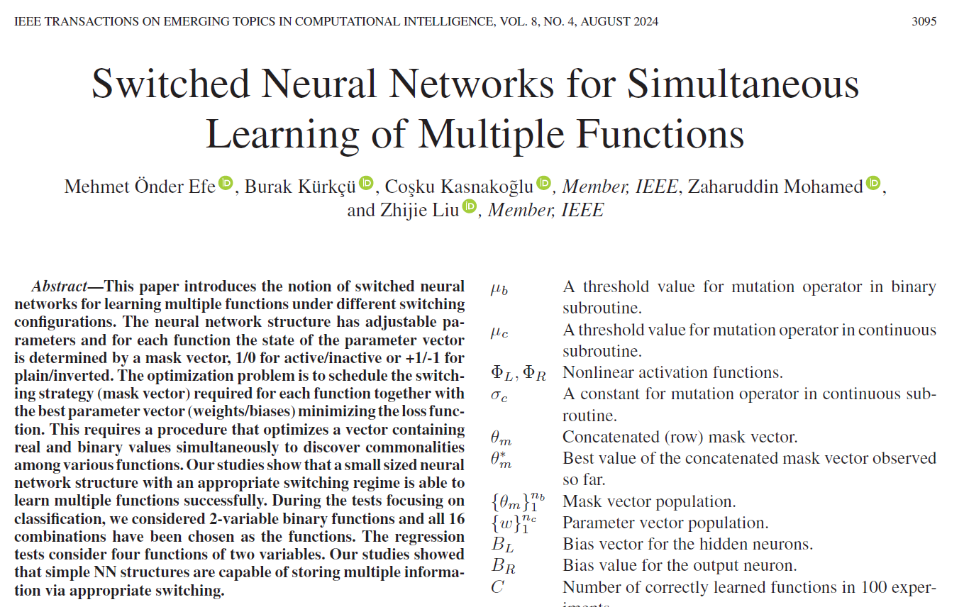

Slide 30
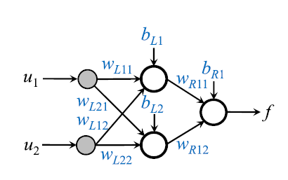
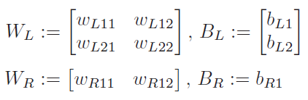

Φ_{R} and Φ_{L} are not differentiable w.r.t. their arguments

Slide 31


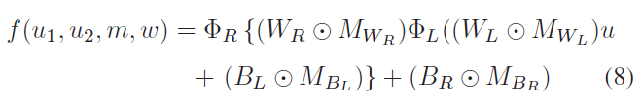

Slide 32
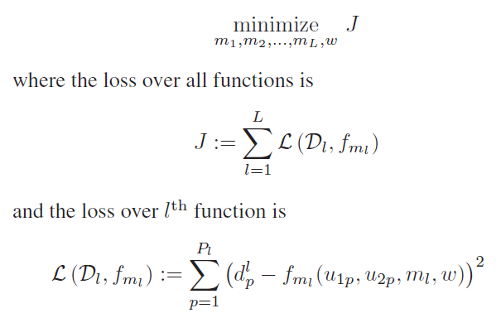


Slide 33
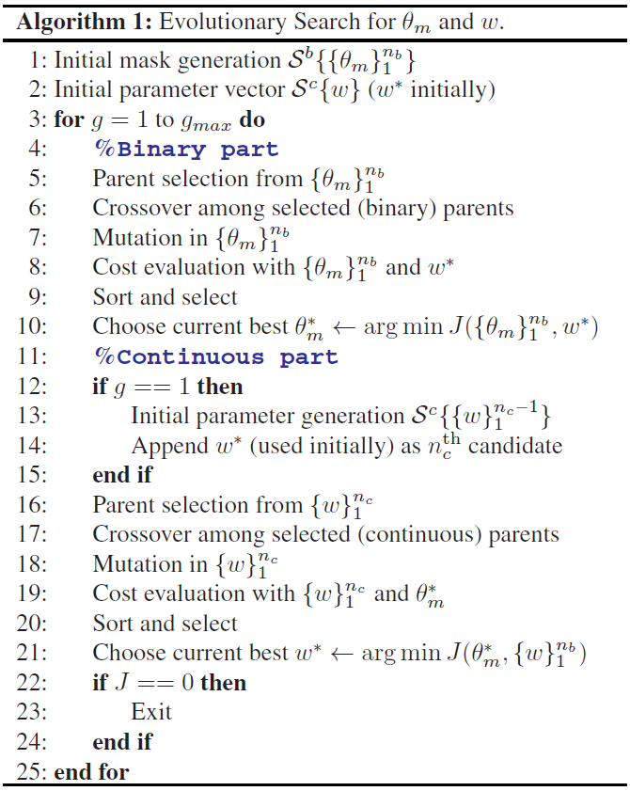
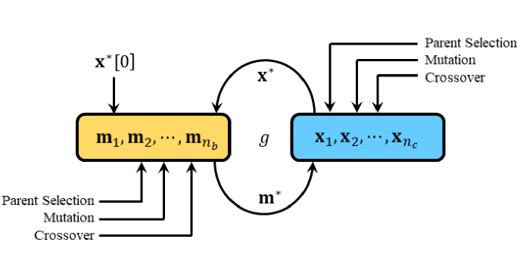

Slide 34
The crossover (line 6) is a two input two output operator that receives two vectors based on roulette wheel selection strategy (parents) and performs several exchanges produce two offsprings. In our study, a random number decides on which strategy to choose for the current parents. Among the equiprobable three outcomes, for the first outcome, we choose single point crossover, for the second, we choose double point crossover and for the last, a random vector α_{b} ∈ B^{1×N} containing zeros and ones is generated and the two offsprings are obtained via the uniform crossover approach defined as shown here.

Slide 35
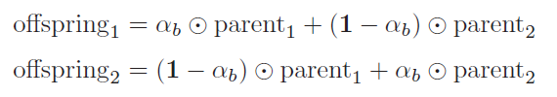

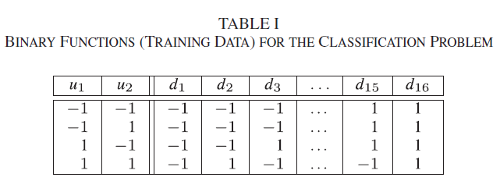

Slide 36
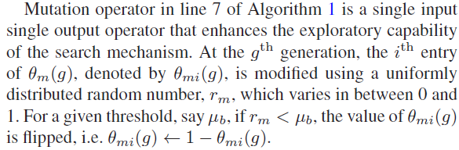
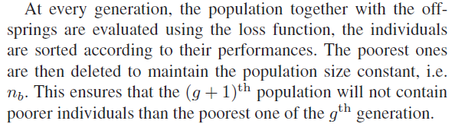

Slide 37
Experiments
We conducted 100 experiments for the each
R ∈ {2, 3, . . . , 25} and in each experiment.
The genetic optimization process has been continued for 1000 generations.
After an experiment is completed, we counted the number of correctly learned functions denoted by C.
The results are given in Table III (next pages), where the values in each row sum up to 100, which is the total number number of experiments for each R.
The columns are the values of C, and for better understanding, we only entered nonzero values to the table.

Slide 38
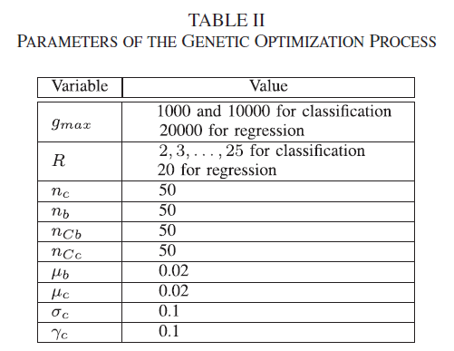

Slide 39
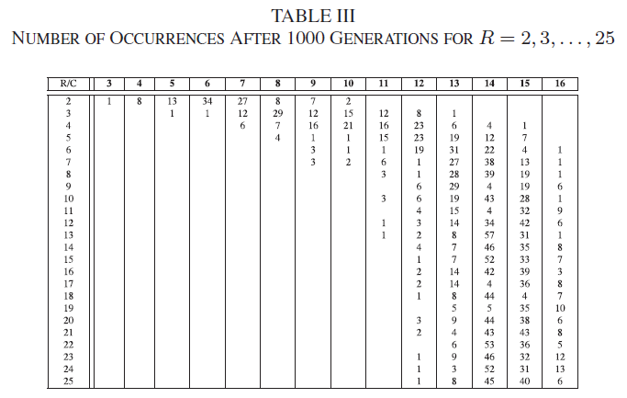
This array adds up to 100. When R=2, ony one experiment resulted in learning of C=3 datasets.

Slide 40
There was one experiment with correct learning of all 16 datasets when R=6

Slide 41
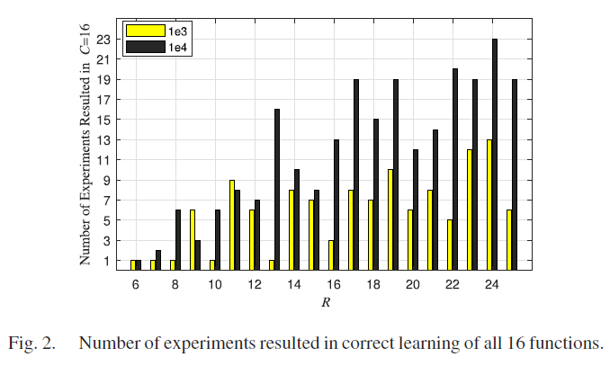

Slide 42
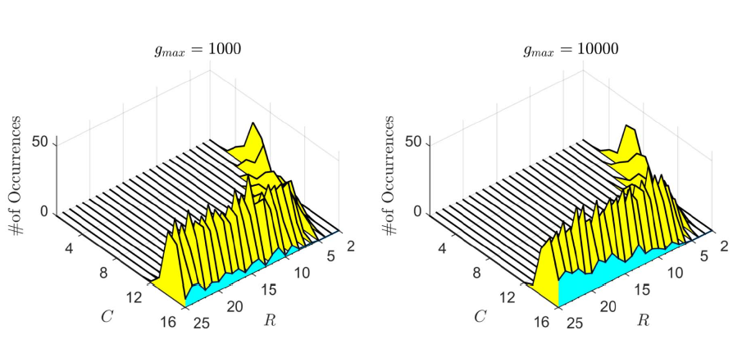

Slide 43
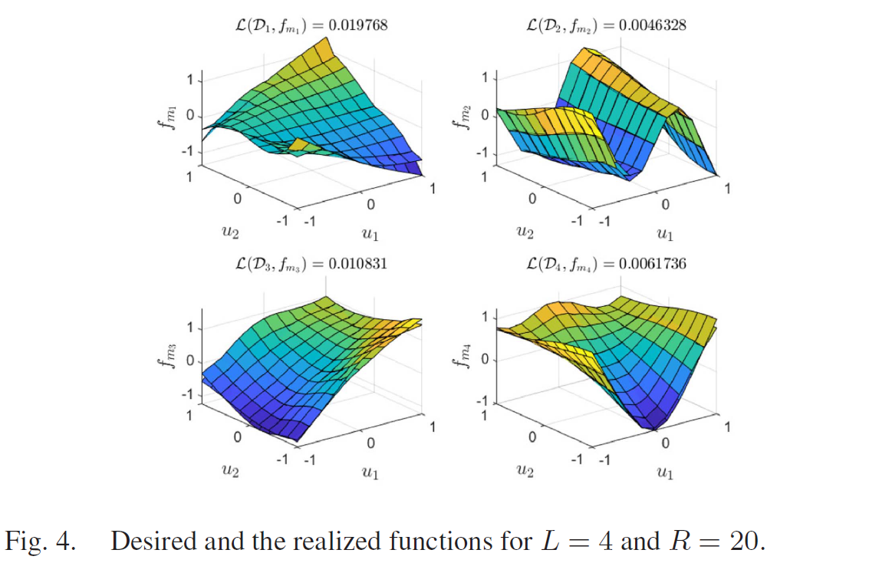

Slide 44
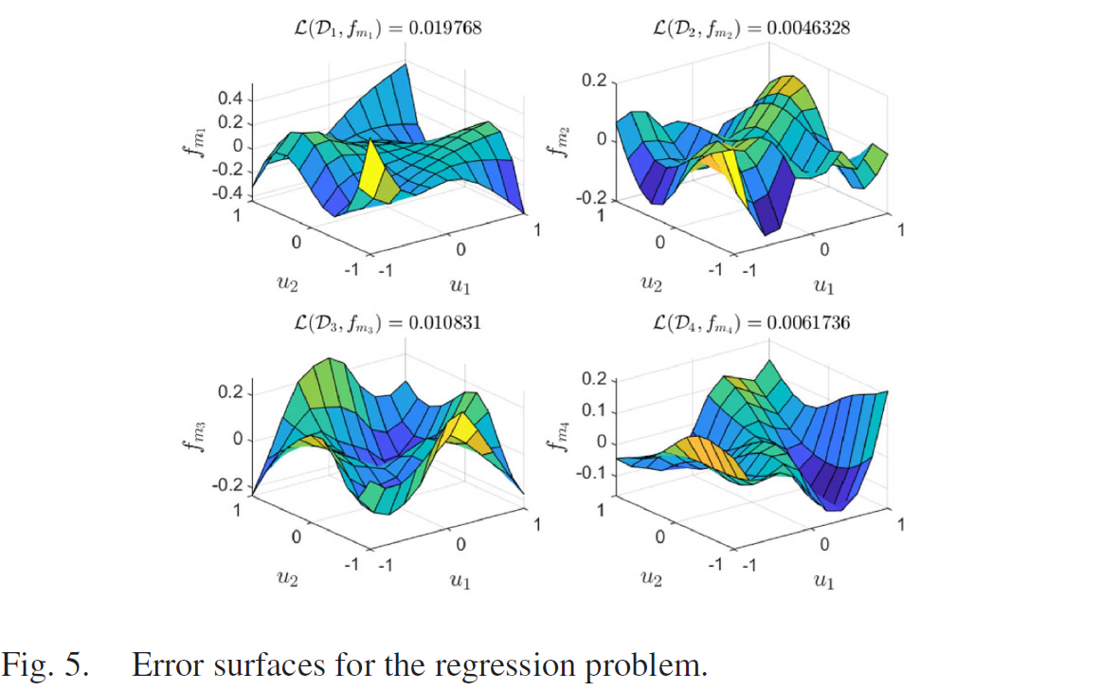

Slide 45
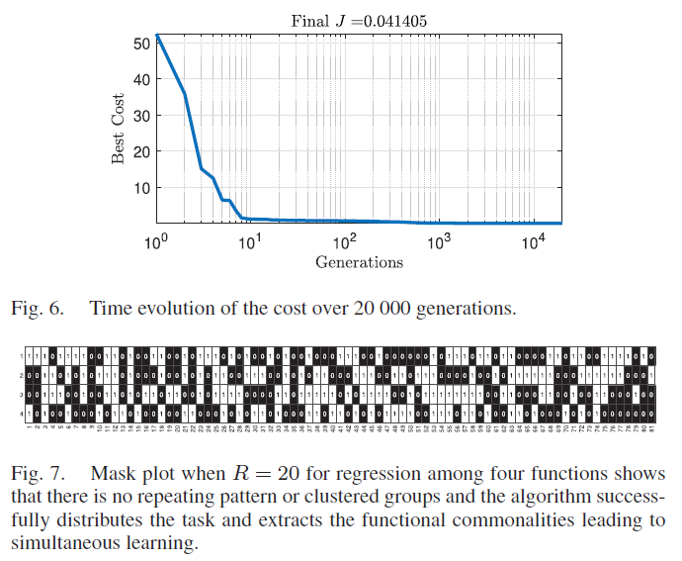

Slide 46
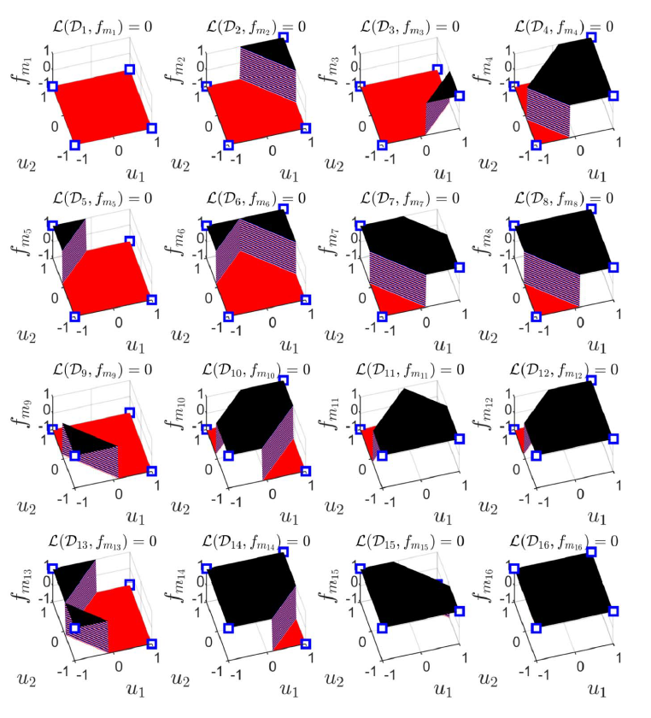
Fig. 8

Slide 47
Bipolar Mask -1/+1 Instead of 0/1
In this section, we reconsider the optimization problem by utilizing a modified mask, which adopts {−1, +1} instead of {0, +1}.
The motivation behind this operation is the available training data, where the values are ±1 in Table I and flipping the sign of a variable is supposed to further reduce the smallest R value obtained in the previous section.
Such a masking strategy does not kill the functionality of a weight, instead, the weight is determined in such a way that its positive and negative values contribute the learning of different functions.
In Fig. 8, the surfaces generated by the algorithm adopting ±1 in the mask is shown. In the figure, the desired values of in each subplot is marked by a square.

Slide 48

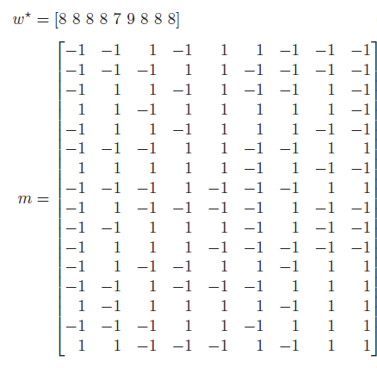

Slide 49
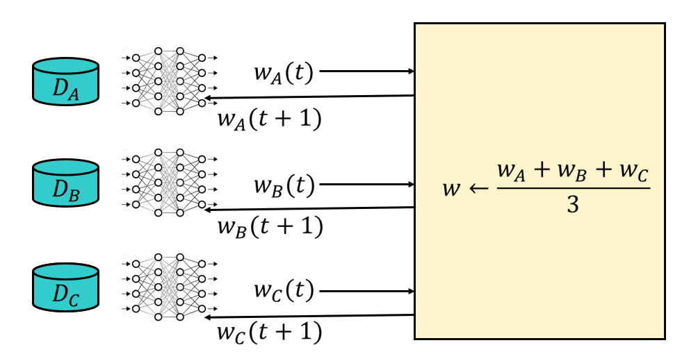
Links to Federated Learning
Multiple dataset learning can be enhanced from the central computer’s side such that the central computer distributes the new weight set together with a private key (mask) vector (m_{i}) that describes the switching vector of each client.
Such an approach improves the privacy of the used data during training and makes it difficult to figure out which data belongs to which user while a generalizing model is provided to each client.

Slide 50
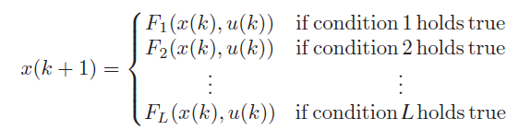
Links to Dynamical Systems and Control
A natural application emerges in Sliding Mode Control (SMC), where the control signal switches in between two different functions and the process is managed by the argument of a signum function.
Since signum function has three possible outcomes, a practicing engineer needs to choose L = 3 and obtain m₁, m₂ and m₃ as well as w that govern the SMC regimes.

Slide 51
Links to XAI
XAI emphasizes the accountability of the building blocks, i.e. their roles, limitations, contributions, pros and cons of their presence/absence and so on.
In the proposed approach, the neurons acting in the network are forced to discover and maximize commonalities among the functions and this is observed better as R decreases.
In other words, the complementary role of the neurons increases in an optimized NN for small R and this reduces the redundancy thereby making use of the unexploited capacity.
As the structure is simplified, the role of each neuron becomes explainable comparably among different switching configurations.

Slide 52
Links to Hardware Implementation
Contemporary hardware realizations utilize FPGAs or similar DSP tools frequently and this is very much subject to management of resources as well as simplicity of models defined via software.
The approach presented here removes the necessity of storing many models within a resource limited environment, and facilitates the execution of multiple mathematical functions while keeping the structure simple and storing several mask vectors in registers.
Further, the solution of the presented approach can be sought in the domain of integer variables or variables having a predefined floating point precision.
We demonstrated that a NN structure can be obtained and reachability of it can be maximized by increasing the network complexity, i.e. R in this paper.

Slide 53
System Identification Example
M.Ö. Efe, B. Kürkçü, C. Kasnakoğlu, Z. Mohamed, Z. Liu, "Masked Multiple State Space Model Identification Using FRD and Evolutionary Optimization," IEEE Transactions on Industrial Informatics, vol.20, no.7, pp.9861-9869, 2024.

Slide 54
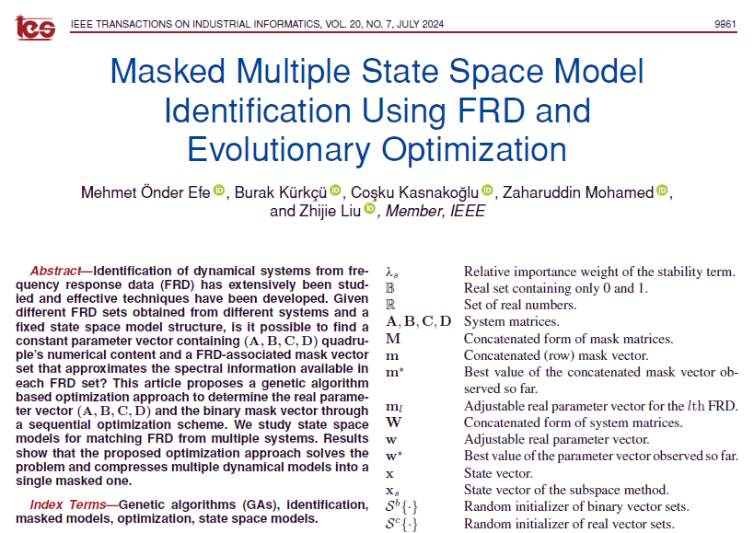

Slide 55
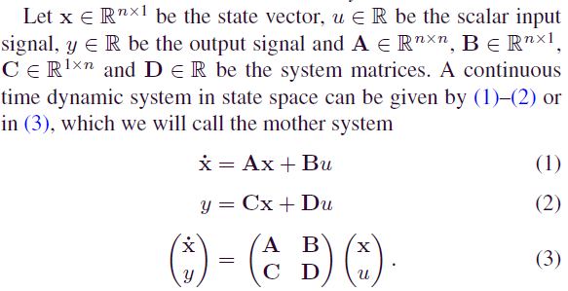

Slide 56
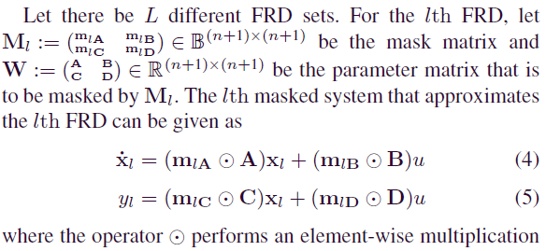

Slide 57
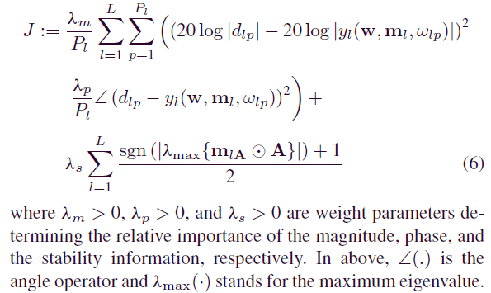

Slide 58
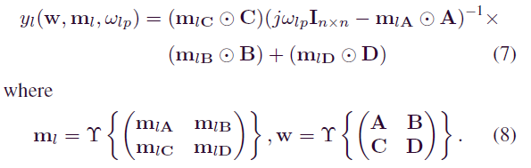


Slide 59
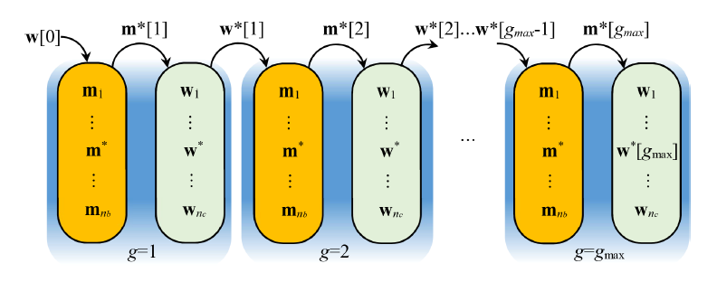

Slide 60
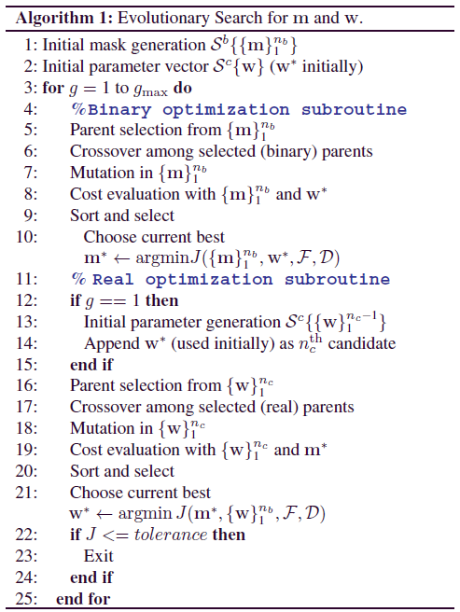

Slide 61
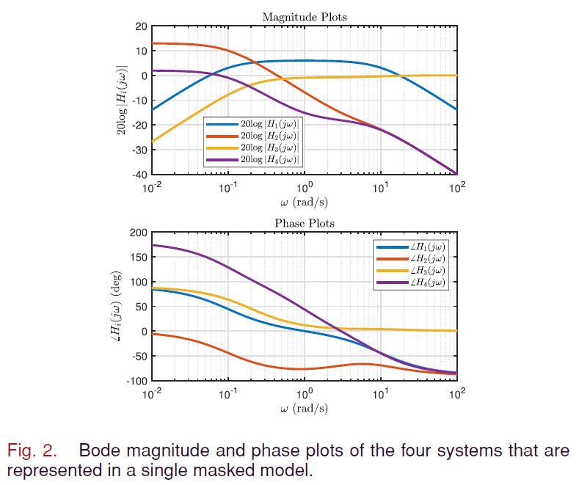
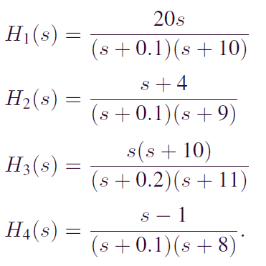

Slide 62
The poles of the four systems that generate the target spectral data seem in two clusters, which are around 0.1 and 10. This is deliberate to see the spectral changes occur within the chosen frequency spectrum. If the FRD generating models have spectral pictures, the meaningful change of which take place at mutually exclusive spectral regions, then packing those into a single mother model would require larger n.

Slide 63
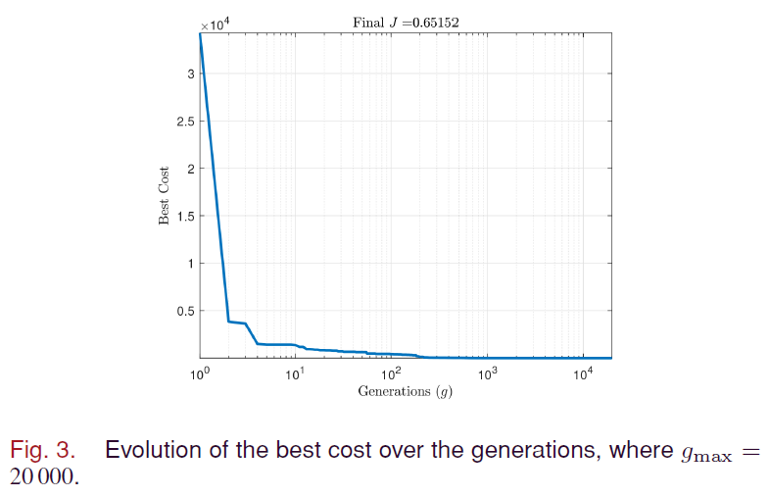

Slide 64
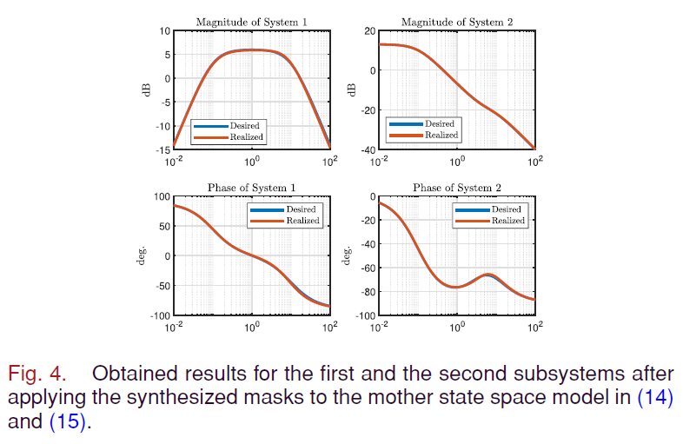

Slide 65
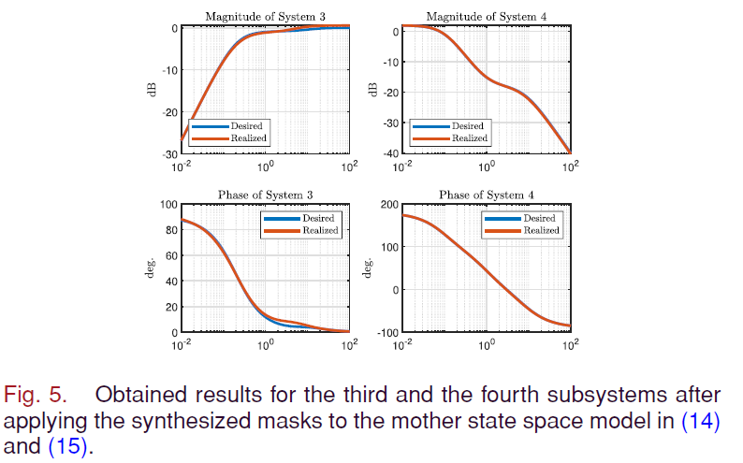

Slide 66
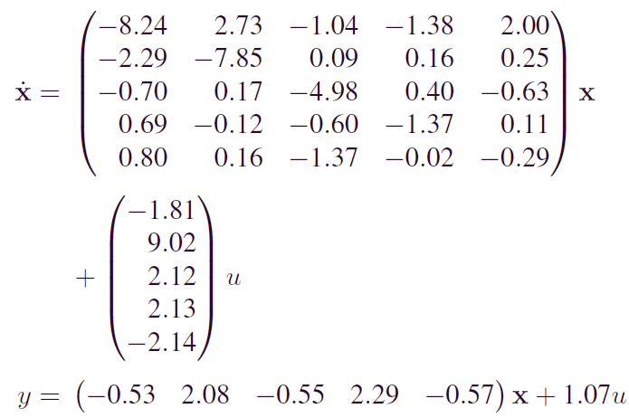

Slide 67
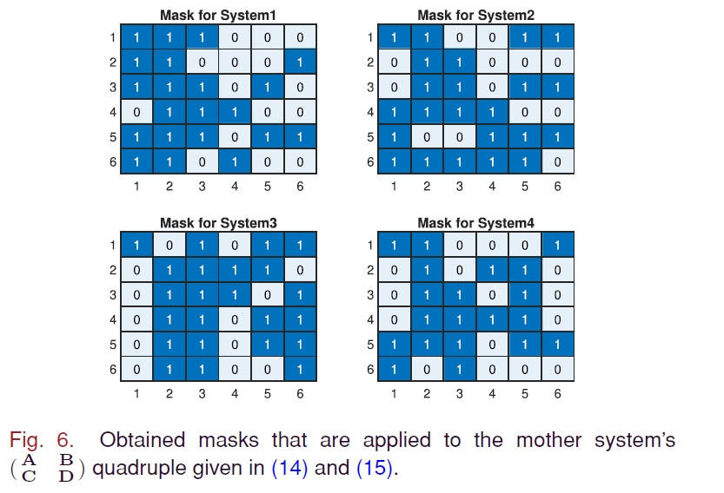

Slide 68

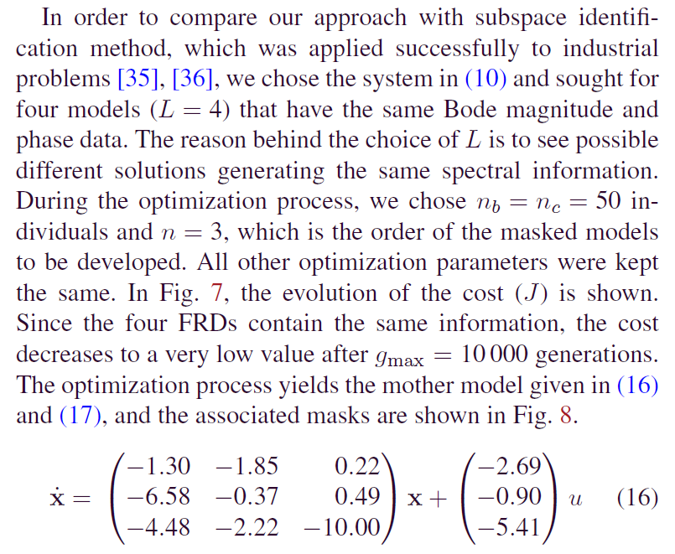

Comparison with SID

Slide 69
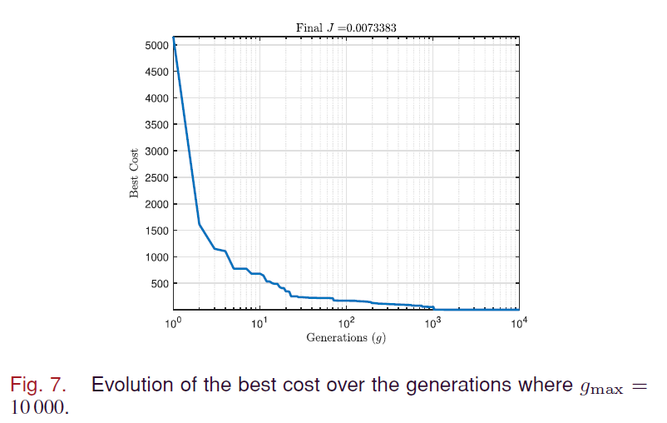

Slide 70
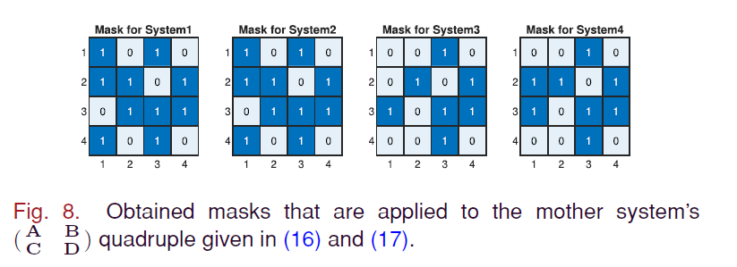

Slide 71
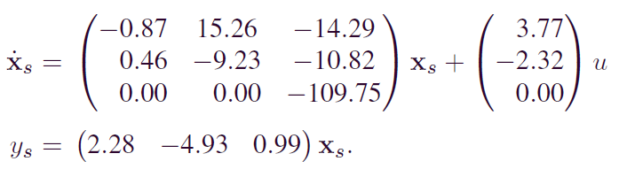
n4sid generates this SS model

Slide 72


Slide 73


Slide 74
Conclusions
Based on the described algorithm and the studied numerical examples, the contribution of the current work is to define an algorithm that encodes multiple spectral information into a single switchable mother model. The work differentiates from the existing body of literature in terms of mask update which is carried out simultaneously with the real parameter update.

